Slide 1

Housing First Ghent
Social housing assistance service
Social service Ghent

Slide 2
Housing First in Ghent
    Origin and history
    Teamstructure
    Target group & selection
    Chronology
    Methodologies
    Strenghts and challenges

Slide 3
Origin and history
Legislative framework in Flanders:
“Kaderbesluit sociale huur”
This results in a cooperation protocol between OCMW and the local social housing compagnies
    1996: Start
    2004: Start accelerated assignment for homeless
    2007: Start “wooncoaching” OCMW Ghent
    2014: expansion of target groups

Slide 4
59 contracts for social appartements/ year
  Distribution under the target groups
    Housing First: 41 contracts
    PAKT ( psychiatric network ): 9 contracts
    Youth welfare: 9 contracts

Slide 5
Teamstructure
ICT Support team
    6,7 full time housing first social workers
    1 full time teamleader
    0,8 full time administrative assistant
!! Housing first social workers always work in pairs with the regular social worker !!

Slide 6
Target group & selection
For whom?
Target group OCMW/ CAW = Structurally homeless
    Multiple vulnerabilities
    Limited income

Slide 7
Admission conditions
    Able to live independently with support
    Be/ think open about support at home
    Fullfil tanent obligations
    Meet registration conditions of the social housing company (no property, language requirements)

Slide 8
For whom not?
    Lower rent = main argument
    Sufficient social support network
    Sufficient skills, power and selfdependency
    Other type of housing or/ and support = more appropriate
    Application during stay in “Project vacancy”

Slide 9
Points of attention
    Torough assessment of the client and his/her strenghts and challenges
    To tailer the guidance to the client, not in function of exclusion
    Residential history
    Rental debt, evictions or nuisance in the past?
    Overview of (legal) family situation
Custody, acces rights

Slide 10
Chronology
  Procedure
    Check admission conditions
    Social report by regular social worker
    Placed on waiting list
    Update regarding client’s current situation
    Assingment Housing First social worker

Slide 11
    Forwarding of the application and social report to the social housing company.
    Effective allocation & First visit
    signing of the contract and support agreement, followed bij the official appartement description
    Tailer made support in the client’s trajectory during installation, stabilization and activation process

Slide 12
Methodologies
    Trust as point of departure in client – social worker relation
    Tempo client
    Tailer made support – departing from the client’s environment point of view
    Accompaniment style = accessible and outreaching
    Support and guidance = mobile

Slide 13
    Concomitant care
    Multidisciplinary
    Empowerment
    Transparency with regard to the clients and the social assistance network
    ICM within OCMW social service structure (activation service, psychosocial service, intern handyman service,…)

Slide 14
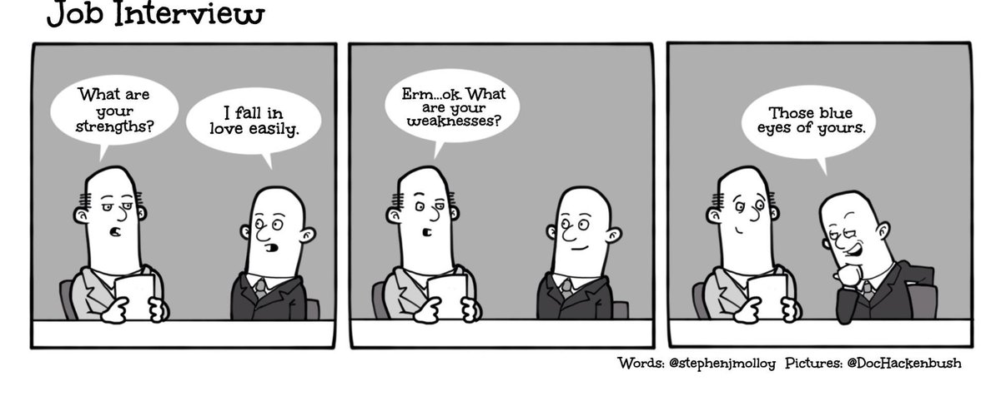
Strenghts and challenges

Slide 15
Strenghts
Cooperation social assistant and housing first social worker
Client centered support
No sanctions or penalty’s by Housing first social worker
Support is not limited in time
Believe in strenghts
Multi-disciplinary

Slide 16
Challenges
Principles Housing First VS. Expectations & point of view social housing compagnies
Process-oriented success = difficult to quantify
transponding “out-of-the-box” assistance methodologie to regular assistance network

Slide 17
Geraldine Serras
Head of departement housing
OCMW Ghent
+32 (0)9/ 266.95.84 geraldine.serras@ocmw.gent
Peter-Jan Heylenbosch
Housing first social worker
Departement housing – OCMW Ghent
+32(0)9/266.92.88
Peterjan.heylenbosch@ocmw.gent

