Slide 1
GHENT HOUSING AND HOMELESSNESS POLICY
JOINING FORCES TO FIND HOUSING SOLUTIONS FOR VULNERABLE GROUPS
Deputy Mayor Heyse (Housing) – Deputy Mayor Coddens (Social Affairs)
ROOF Final meeting Phase 1 11 February 2020

Slide 2
WHY
Notes:
Deputy Mayor Heyse
Present yourself
We would like to welcome all of you,
In the first place, we are welcoming our partners from all over Europe. We’re glad you chose to be engaged in the ROOF project and we are confident that this network has everything it needs to succeed.
Secondly, we are also welcoming the Urbact Local Group members. The continuing engagement of our local stakeholders is very important for us to succeed in our task of ending homelessness.
In this short presentation, we would like to give you some insights on the reasons why we started ROOF and how it is related to our current policy in Ghent

Slide 3
WHY Ghent started URBACT APN ROOF
Ghent advocates the right to housing for all (signed UN Shift and EU Pledge)
BUT:
housing crisis, also in Ghent: lack of affordable housing stock especially for vulnerable groups
350-500 known chronic homeless people, +/- 1,400 unique users of night shelter, estimate of 100 families (often without legal residence) ! no complete numbers available
issues of migration (EU and non EU) and of societalisation of residential social services; growing diversity of target groups
AMBITION: - longterm goal of functional zero (no more structural homelessness)
=> need for inspiration from other European countries on housing solutions
Notes:
Deputy Mayor Heyse

Slide 4
WHY Ghent started URBACT APN ROOF
Choice for
- exploring how to implement Housing First (cf Finland)
- exchanging methods for data collection
ROOF AMBITION:
- create an integrated action plan that combines housing and homelessness
- influence national and European homelessness and housing politics
Notes:
Deputy Mayor Heyse

Slide 5
A POLICY SHIFT
Notes:
Ghent is making a policy shift concerning homelessness

Slide 6
From managing homelessness…
Past policy
SHELTER/ TEMPORARY HOUSING
SUSTAINABLE/
PERMANENT
HOUSING
PREVENTION
Notes:
Deputy Mayor CODDENS: Historically, Ghent has followed a staircase approach to homelessness. Over the last years, we developed a mix of different approaches, Prevention, Shelter and Temporary housing, and some Sustainable Housing solutions. In recent years, homelessness has been viewed mainly as an aspect of poverty. Therefore, the Ghent homelessness plan was integrated in the bigger poverty reduction plan. Today, we can say that
(Left side of the slide) Ghent has some good measures to prevent homelessness, but still people are becoming homeless.
(Right side of the slide) we have some interesting sustainable housing solutions, but that only just suffices to prevent a further rise of homeless people. A group of minimum 350 long term legal homeless people still doesn’t have a sustainable housing solution
Finally (the middle of the slide) a big part of our homelessness policy still consists of shelter and temporary housing solutions. Therefore, we can state that we are mainly managing homelessness instead of ending it. And of course (pointing to the next slide) we want to end homelessness, because we know it’s doable.

Slide 7
... to ending homelessness…
New policy
SUSTAINABLE/ PERMANENT HOUSING
SHELTER/ TEMPORARY HOUSING
PREVENTION
Notes:
Deputy Mayor CODDENS: In the coming years, Ghent wants go from managing to ending homelessness. We want to do this by further investing in prevention and in structural housing solutions. As a result, the need for shelter and temporary housing will become less.
The ROOF Project focuses on structural housing solutions: how to realise more sustainable housing for the homeless, starting from the inspirational examples of housing first and housing led in different countries over the world. Of course, over time, the effects of the ROOF project will have an impact on Prevention and Shelter.

Slide 8
... through structural housing solutions
SOCIAL SUPPORT AND
WELLBEING
HOUSING
Notes:
Deputy Mayor CODDENS: When we speak of structural or sustainable housing solutions, we already know that they will consist of two main aspects:
Firstly, the housing itself, the bricks, the stock of housing and its typology in the city.
Secondly, the support, because people who are long term homeless are known to deal with complex problems – combinations of poverty, a lack of network, psychiatric problems, addictions, health problems, etc.
The only way the housing solutions can work is if we work on both aspects equally and make sure that Housing and Support are well integrated.

Slide 9
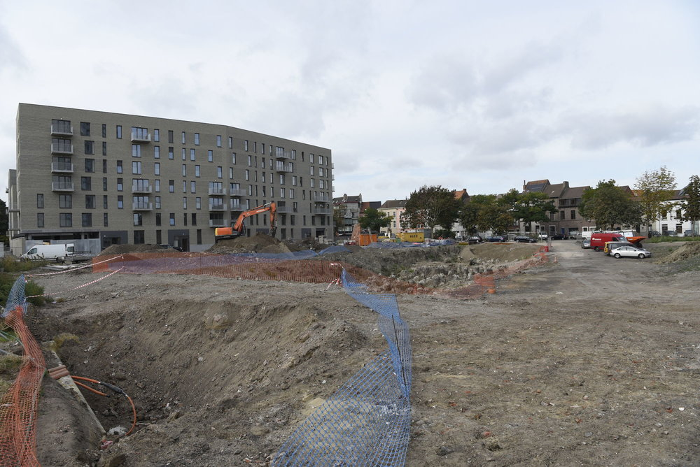
HOUSING AND HOMELESSNESS POLICY UNITING FORCES
Notes:
Deputy Mayor HEYSE: In the framework of ROOF, Ghent really makes a statement in terms of policy collaboration.
Since housing for homeless is a multidimensional solution, we need several different policy domains to collaborate on this. In Ghent the deputy mayors of Housing and of Poverty, Homelessness and Social Affairs have chosen to unite forces. This is why we make a joint presentation, to show you our collaborative approach on sustainable housing for the homeless.
We also have a Taskforce Housing and sheltering that works on housing solutions for vulnerable groups together with local stakeholders (I will explain more near the end of our presentation).

Slide 10
Housing policy
HOUSING FOR THE HOMELESS
92 million euro for 6 years
Focus on structural solutions
expanding housing stock
social and private rental stock
lowest incomes
families with children
improving quality
Integrated master plan for social and affordable housing
Notes:
Deputy Mayor HEYSE: We will start with our housing policy. Allthough we cannot cover the whole policy in this presentation, we want to give you a quick insight in the most relevant aspects of it. (verder voorlezen/duiden van de slide)

Slide 11
Social support and wellbeing policy
HOUSING FOR THE HOMELESS
Delivering Housing First support
2019: 238 trajectories
Delivering Social Rental support
2019: 329 trajectories
Optimising Shelter system
Outreaching services
Integrated Poverty Reduction Plan
Notes:
Deputy Mayor CODDENS: As for the social support and wellbeing policy for homeless people we do a number of things:
We deliver Housing First and social rental support. In 2019 we had 238 trajectories of Housing First and 329 trajectories of social rental support. Our Housing First system has proven successful. For the future we have to make sure the support can keep up with the planned expansion of housing first
We are optimising our Shelter system
We also have outreaching services to make sure we keep picking up urgent problematic situations on the streets
Our homelessness policy is part of an integrated Poverty reduction plan.

Slide 12
Joint policy projects
HOUSING FOR THE HOMELESS
Social housing companies:
41 units per year are available for Housing First for homeless people,
9 units per year are available for young people for guided independent living
9 units per year are available for people with mental issues
Doubling social rental units for vulnerable groups to 532
Building 11 Robust housing units (Skaeve Huse)
Notes:
Deputy Mayor HEYSE
To conclude, we will give you a short overview of some of the highlights of our new policy concerning housing and homelessness:
Firstly, we have 41 units available extra each year to house structural homeless people. This is our Housing First project.
Secondly, the Social Rental Office has the ambition to double their number of units to 532 in 2025. When taking the ETHOS LIGHT definition of homelessness, 80% of the people who are housed by the Social Rental Office were former homeless people. So this is also an interesting solution for Housing First or Housing Led.
Thirdly, Ghent will invest in some housing projects for specific target groups. One of those that we are building right now are the Robust Houses, based on the Danish concept of the Skaeve Huse. We are building 11 houses that deliver social and physical tranquility, especially for people who do not function well in high density areas and need a stable environment to recharge and work towards more quality of life.

Slide 13
Joint policy projects
HOUSING FOR THE HOMELESS
Expanding temporary accommodation for Intra European migrants
Shelter and orientation system for people without legal documents or with a precarious status
Post mobile housing
Notes:
Deputy Mayor CODDENS:
We also plan to expand temporary accommodation for Intra European Migrants, a group with complex issues, and specific legal status issues. They need to find work here, but for that they need an address. But most landlords only rent to people who already have a job. Catch 22.
We are very excited to start a shelter and orientation system for people without legal documents or with a precarious status. The aim is to help them either organise their documents and go from there or if there is no solution help them to go back to their country of origine.
We are preparing temporary accommodation for people who currently live in mobile units and barracks etc in places where they are not meant to live.

Slide 14
Joint policy projects
HOUSING FOR THE HOMELESS
Renovating with recurring funds (UIA)
Taskforce Housing and Sheltering
Notes:
Deputy Mayor HEYSE:
Ghent has got funding from Urban Innovative Actions to set-up a recurring fund for renovation of bad-quality housing from poor owners who do not have the means to renovate themselves. The investment is returned only when the people are re-selling their house.
Finally, and this is connecting a lot of the former policies, Ghent has set-up a Taskforce Housing and Sheltering. This is a network collaboration platform where all relevant stakeholders that are connected to poverty, housing, wellbeing and others working together on the presented policies.
The taskforce is mainly meant to work in co-creation, to gather information and engagement from the working field, and also to have instant feedback-loops on planned and realized policies.
We hope that this short overview gives you some insight on how Ghent is trying to cope with homelessness and how housing plays a role in the solution. We also hope that through ROOF we all can inspire each others policies and action plans so that we finally in the coming years might succeed in ending long term structural homelessness in our cities.
We wish you a very inspiring and rewarding gathering the coming two days and a beautiful project the coming two years. We hope to see you all back here in two years for the final meeting.

Slide 15
Thank you for listening! Any questions?
Patricia Vanderbauwhede Steven Vanden Broucke
Policy advisor Policy advisor
Housing service Social service
patricia.vanderbauwhede@stad.gent steven.vandenbroucke@stad.gent
City of Ghent - Belgium

