Slide 1
Notes:
Hoofdslide

Slide 2
Project management
TM Ghent 12/2/20
Notes:
Tussentitel versie 1 / niveau 1

Slide 3
Getting ready for phase 2
Notes:
Tussentitel versie 2 / niveau 2

Slide 4
Timeline
Phase 2 Application:
Feedback on draft proposal by all PPs: 20/2
Deadline for signed Letters of Commitment: 20/2
Submission application form: 2/3
Start phase 2: 14/5
When approved: period between 2/3 – 14/5 is eligible as well

Slide 5
Letter of Commitment (LoC)
Fixed template on Basecamp
Signed by elected representative
Any PP without elected representative?
Scanned LoCs are compulsory part of the application
If 1 is missing, our appliciation is NOT eligible
Get 2 copies signed: 1 for you, 1 for LP
Scan to LP by 20/2
Original to LP by 25/2 (see Basecamp for address)
Round of the group

Slide 6
Roles in phase 2
Project coordinator (involved in transnational level)
ULG coordinator (local level)
Finance Officer
Communication Officer
some roles can be combined
URBACT Guidelines: 1 full-time
Project coordinator: good knowledge of English!

Slide 7
Budget phase 2
Notes:
Tussentitel versie 2 / niveau 2

Slide 8
General principles
Budget Phase 1 + Phase 2 = 750.000€ max
Budget phase 1: 149.818€
Unspent budget from phase 1 > phase 2
PPs Less Developed regions:
80% for staff and external expertise due to difference in salaries and costs
Travel & Accommodation: 100%

Slide 9
From proposal to final budget
Step 1: decide on number and hosts TMs e.o.
Budget for hosting TM: 4.000€
Step 2: adapt the propsal to you local needs by 18/2
Total budget per PP is fixed, you cannot exceed that
Pay special attention to
Staff (on the payroll of the official partner organisation) vs External staff (freelancers, cooperating agencies, hired external project coordinators,…)
T&A: only for staff that is on the payroll of your organisation
For ULG-members, external project coordinators,…: ExEx non-staff travel
Costs for FLC

Slide 10
Recap: budgetlines in URBACT
See ppt on project management TM Naples for extended info
Budgetline | What? | Underlying evidence
STAFF | Staff on the payroll of the official PP Max. 35-40% of your budget can go to staff & external project coordination | Timesheets (unless full time on project – almost impossible with URBACT budget)
OFFICE & ADMIN | Overhead | None. Automatically 3% on staff
TRAVEL & ACCOMODATION | Costs for travel (plain, public transport, car) and hotel, meals, daily allowances and visa costs Unitcost of €650 per person per travel Only for staff of the official PP | Original boarding pass, trainticket, hotel invoice,… Agenda, meeting minutes, attendance list,..
EXTERNAL EXPERTISE | Expertise and services provided by a public/private body or a natural person outside of the partner organisation Costs paid on the basis of contracts, by invoice or reimbursement request | Public procurement: evidence of selection process Contracts mention clear link to ROOF/URBACT Outputs produced (study, video, translated doc,…), invoice

Slide 11
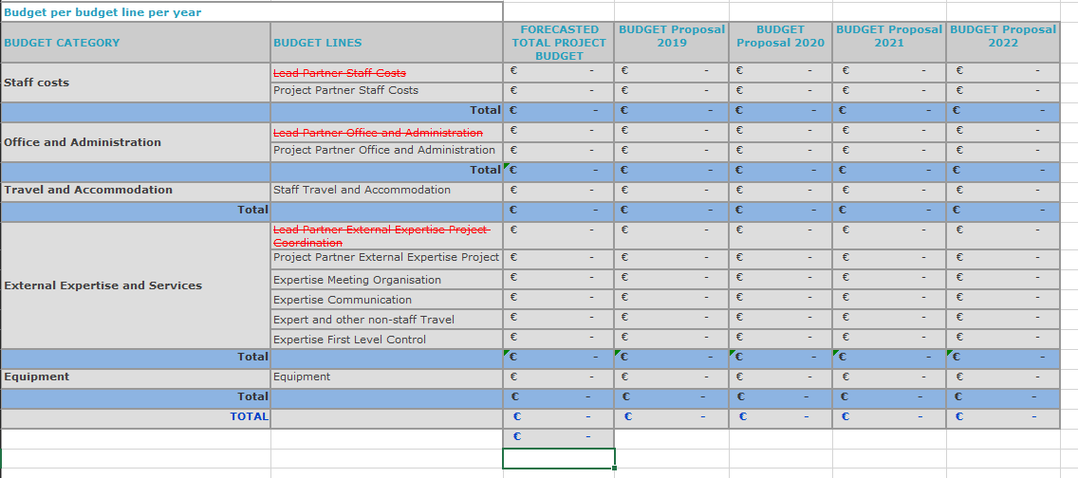
How it will be visible in the application form

Slide 12
Budget flexibility
Minor changes
20% flex between budgetlines
No formal procedure – explain in the Progress Report
Major changes
Only once
Prepared in the Mid Term TM
Formal procedure nov 2021 – feb 2022
For devitiations in the budget above 20%
Between budget lines
Between partners
Argumented and approved by the Monitoring Comittee
Formal reprogramming of the project

Slide 13
Small Scale Actions (SSA)
“A Small Scale Action is experimentation. It is an idea or a concept, perhaps already tried in another city, which can be tested to check the relevance, feasibility and added value of its implementation in different local contexts“
Limited in time and scale
The right to fail
Test > measure > evaluate > (not) adopt in your IAP
! No infrastructure investments (never in URBACT)
Max. 10.000€ per PP – up to you on which budget lines
Completed by September 2021 > lessons included in first draft IAP
Read more in the Guide to APNs p 17-19

Slide 14
Claim 1
Notes:
Tussentitel versie 2 / niveau 2

Slide 15
Reporting rounds
3 reporting rounds
Phase 1: 1 claim
Phase 2: 2 claims (yearly)
Payment claim:
Progress Report: reflecting the progress on partner and network level & deliverables
Reporting per WP
WP3: Local actions – main input from PPs
LP asks input from ALL PPs
Edited & submitted by LP in SYNERGIE
Financial Reporting

Slide 16
Synergie
SYNERGIE: project management platform for claims, progress report,…
https://synergie-cte.asp-public.fr/
Everybody has access?
Guidelines on Basecamp > Docs & Files > Phase 1 reporting – SYNERGIE Guidance Notes

Slide 17
Financial reporting Phase 1
2/04/2020 | 8/04/2020 | 15/05/2020 | 28/05/2020 | 02/06/2020
Input Synergie of all costs | All cost are validated | Collecting all signed certificates | FLC LP grouped claim | Deadline claim to URBACT
Lead partners & Project partners | LP and PP | PP and LP | LP | LP

Slide 18
Input expenditures Synergie
Deadline: 02/04/2020
Input ALL expenditures in Synergie
Costs made Phase 1 period:
2nd September till 2nd March
Corresponding budgetlines without exceeding maximum amount
Flexibility 20% between budgetlines and between partners

Slide 19
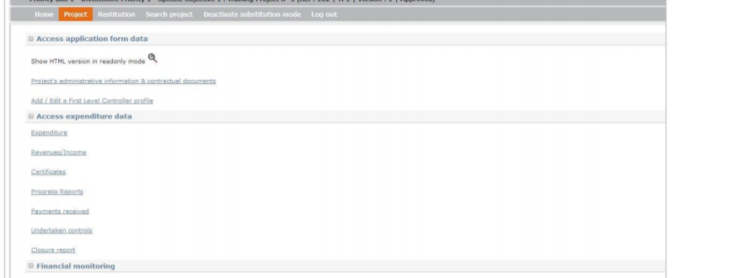
Input expenditures Synergie

Slide 20
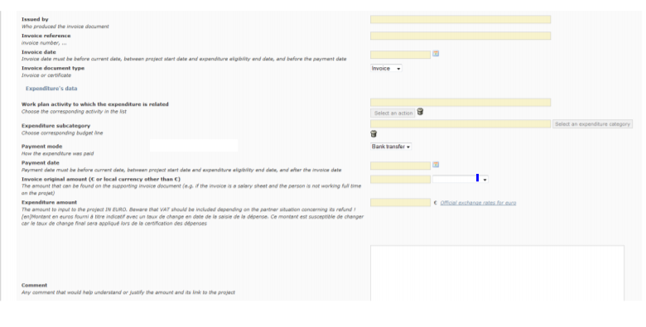
Input expenditures Synergie
Comment should justify the amount and link to project
WHY WHEN WHO WHAT
Ex: travel cost => train ticket – Patricia V – Paris – Ghent – 11/09/2019 – training URBACT

Slide 21
LP validates expenditures
Deadline: 08/04/2020
LP checks if everything is correct
Workpackage wrong
details incomplete
Cost wrong budgetcategory
If there are still mistakes =>
PP corrects and validates again
Expenditures correct
LP validates
Cost are available for FLC now

Slide 22
PP sends signed certificates LP
Deadline: 15/05/2020
FLC can check and certify
Set a date with your FLC so you will be on time!
After approval FLC you can download the certificate in Synergie
FLC signs the certificate
PP sends by email to sana.liou@stad.gent
LP collects all signed certificates by 15/05/2020

Slide 23
FLC LP signs grouped claim
Deadline: 28/05/2020
After receiving all signed certificates from PP
LP FLC delivers grouped claim certificate
Financial part of the progress report can only be completed after all PP claims are certified in SYNERGIE

Slide 24
LP sends to URBACT
Deadline: 02/06/2020
Documents to be submitted by LP
Certificate of expenditure per partner signed by FLC
Payment Claim grouping all certificates by LP
Progress Report by LP with input from partners

Slide 25
Appointment FLC SYNERGIE
Check your system in the URBACT Guide to Network Management > Annex 4 (p. 28-32)
Centralised system = State FLC
Costs mostly borne by Member State
Get in touch on national rules and timeframe
Romania, Greece, Poland, Belgium Wallonia
Decentralised system = you appoint your FLC yourself AND gets approved by Approbation Body
public procurement rules in case you chose external controller!)
FLC needs to fill in a questionnaire checklist with details, skills,…
Word-version on Basecamp – final version need to be filled in online
Check Annex 4 for contact details Approbation Body
Costs borne by PPs budget
UK, Denmark, France, Belgium Flanders, Portugal

Slide 26
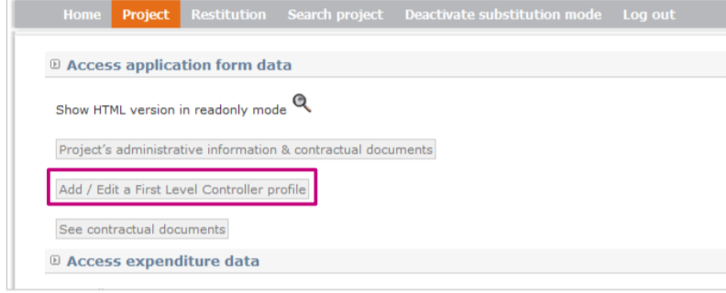
Appointment FLC SYNERGIE

Slide 27
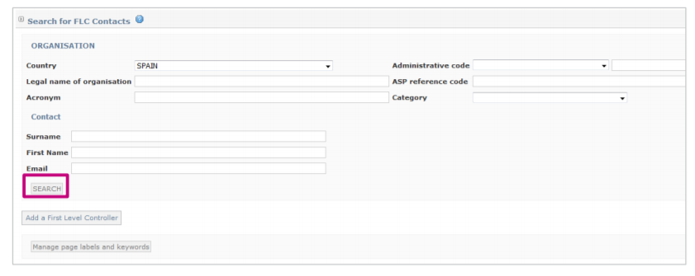
Appointment FLC SYNERGIE

Slide 28
Appointment FLC SYNERGIE
Select correct FLC in list or make new one in Synergie
Fill in checklist in SYNERGIE
Email your national contact point validate your FLC in SYNERGIE!
See link list contact person
FLC will not be able to validate costs in Synergie if not validated

Slide 29
Guidelines Synergie
Basecamp: APN ROOF > Docs & Files > Phase 1 Reporting – SYNERGIE GUIDANCE NOTES
Be sure to check following guidance notes:
Guidance Note1: Getting the FLC approved
Guidance Note 3: Accounting Expenditure
Guidance Note 7: Entering ERDF & Exports

Slide 30
Support on project management
Ghent team:
Ariana.Tabaku@stad.gent
General project management & contractuel documents
Contact point URBACT secretariat
Sana.Liou@stad.gent
Financial reporting & Synergie
URBACT III Programme Manual: please read carefully
Factsheet 2A Action Planning Networks
Factsheet 2E Network Management
Factsheet 2F Financial Management & Control
Sessions in transnational meetings
If needed, telco or Skype sessions

